Slide 1

IMPROVING PROFITABILITY IN A GROCERY STORE THROUGH SALES STRATEGIES AND INVENTORY OPTIMIZATION
VAISHANAVI MEHTA
22F3000439

Slide 2
DETAILS OF THE ORGANIZATION: cat The name of the shop is Tanishka Enterprises which is an 8-year-old shop located in Bagru, Jaipur. It is a grocery (Kirana) store and was established in 2016, with an initial investment of around 2.7 lakhs, including the renovation costs, and initial inventory. The store is situated in a small, close-knit locality which underdeveloped, however is in close proximity to 2 major educational institutes, one is a big private university with about 10,000 in-house students and one is a local school. Hence, its main customer base are the locals, and students between the ages of 18-22. The store only has one employee, apart from the owner, who manages accounts, sales and inventory by himself; that is a part-time driver carrying out home- deliveries.

Slide 3
The 3 step Process [SPS]
Tracking Sales
Identifying Problems
Implementing Solutions
After building an extensive rapport with the shop owner and multiple in-person discussions, 24 items were selected as the main focus of this project. Since the store is in a small shop in a remote area, no electronic record of sales was maintained. Handwritten records were collected every week and transferred to an excel sheet to be cleaned and analyzed.
After 31 days of data collection, the numbers were analysed using Excel tools and graphs, and a problem statement became clear. Based on this, a series of possible solutions were ideated on, and proposed to the shop owner to discuss viability. Following this, strategies of implementation were finalized.
Based on discussions, Home-delivery services, advertisement strategies, Seasonal items, profitable combo offers and diversification of vendors were put into place, followed by other suggestion for future. The numbers after the new strategies, were analysed and significant insights came into light.

Slide 4
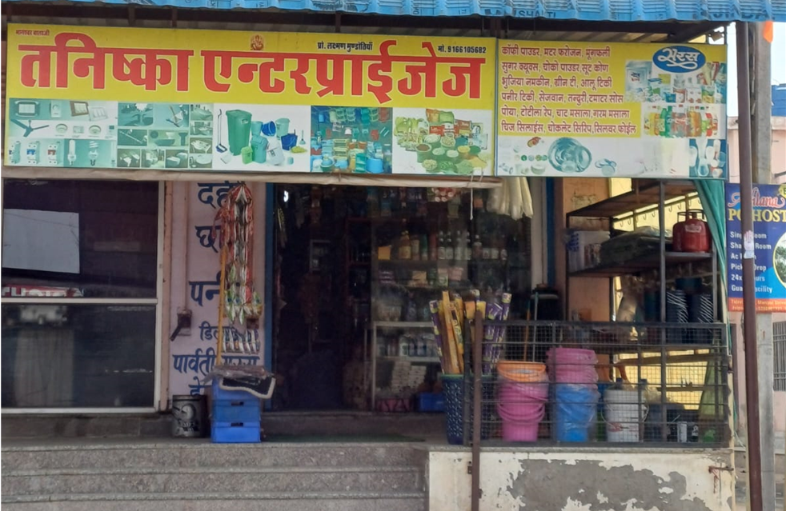
01
The business is facing 2 major problems listed as below- 1. Stagnant Revenue generation: The store has not seen much increase in net profit since its establishment, and even less with the propagation of online stores. This is due to 2 primary factors. i. Limited customer base. ii. Excessive competition 2. Inventory Management: The store owner finds it hard to manage inventory since a lot of items are always in surplus that takes up a lot of space, and causes product damage/ wastage. This is due to 2 primary factors i. Overstocking due to distance and dependence on singular supplier ii. Lack of proper records
PROBLEM STATEMENT

Slide 5
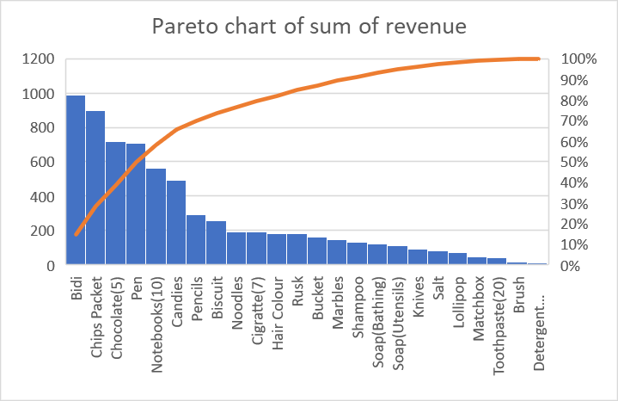
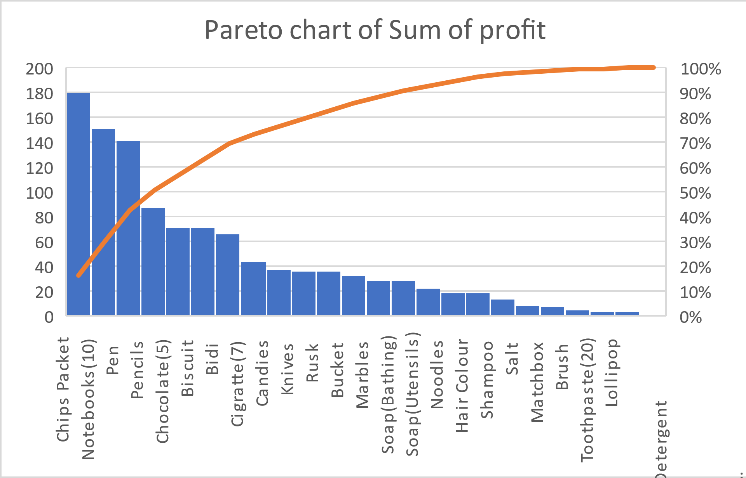
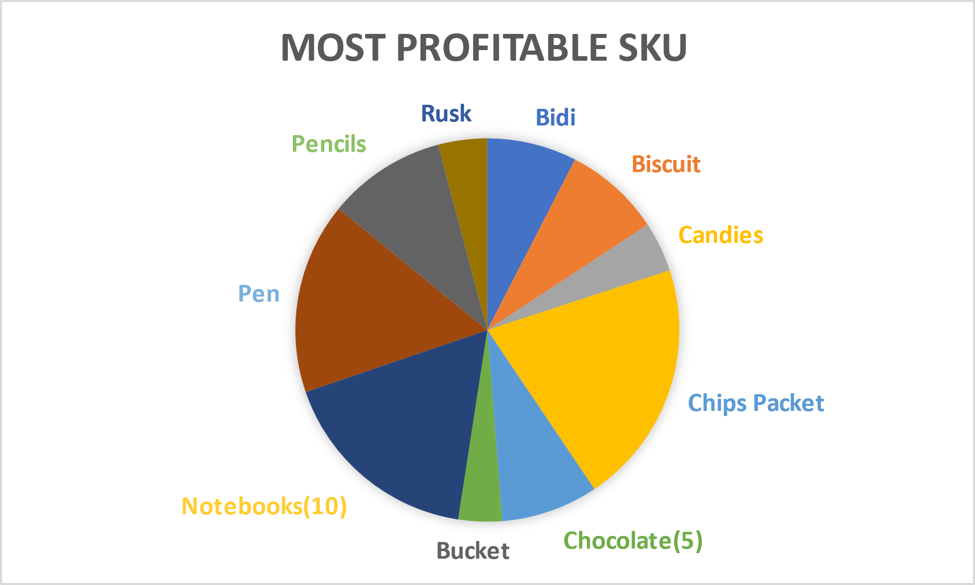
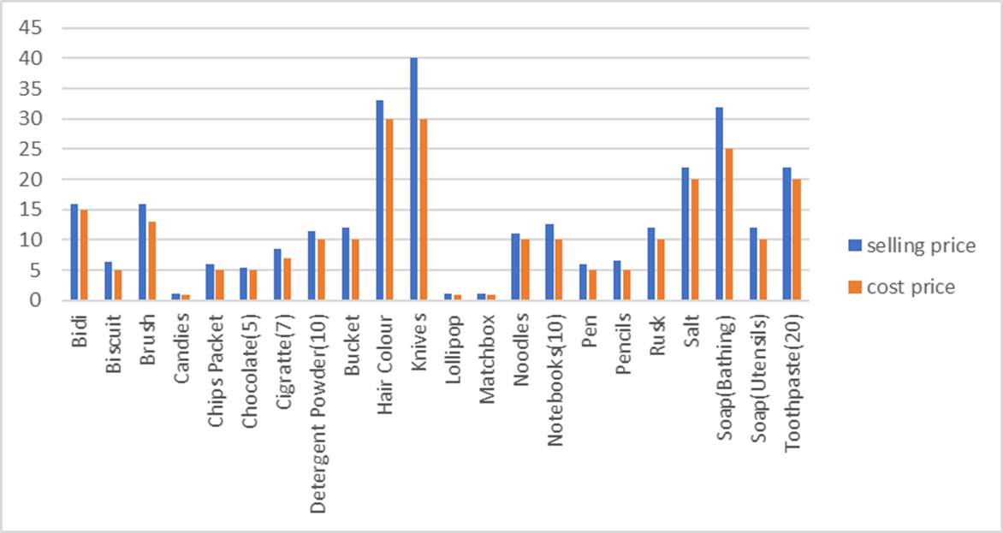
Preliminary Analysis
Based on average number of units sold vs profit/unit
(This data is the culmination of data collected over 31 days, about 24 SKUs in particular chosen due to multiplicity of reasons.)
These were the major insights at the end of 4 weeks.
Average profit generated per month is around 1.1k
Marbles are sold in the highest quantities but have a very low profit margin.
Knives have the highest profit margin (10rs) but are slow-moving items
Chips is the most profitable item, closely followed by notebooks, due to their above average profit margin as well as sales.
Singularity and distance from vendor is causing continuous overstocking and spoilage
There are no fluctuations in the purchasing price of the SKU’s.
Bar graph showing cost price vs selling price

Slide 6
4 Key Strategies
Home Delivery Services
Seasonal Items
Starting a routine home-delivery service at 6pm everyday for a radius of around 15kms, with extra charge (35rs) for instant delivery at minimum order of 70rs. This was done using the owner’s scooter and hiring an extra helper. Appropriate advertisement was also implemented.
Since the data is collected through the months of March, Holi was a major festival in the duration. This occasion was capitalized upon by adding temporary, seasonal items to the inventory. An assortment of Holi colors and Holi water guns were offered through weeks 1, 2 and 3.
Vendor Diversification
Profitable Combos
The benefits to vendor diversification, from 1 to 2 based on edible and non-edible items were as follows. Firstly, this mitigates problem associated with inventory management and Secondly, the risks associated with dependency on a single supplier are also eliminated.
Lucrative combos, not only entice the customer to spend slightly more, but in our case, also would significantly help in clearing of slow-moving items, or items vulnerable to spoilage, without any wastage.

Slide 7
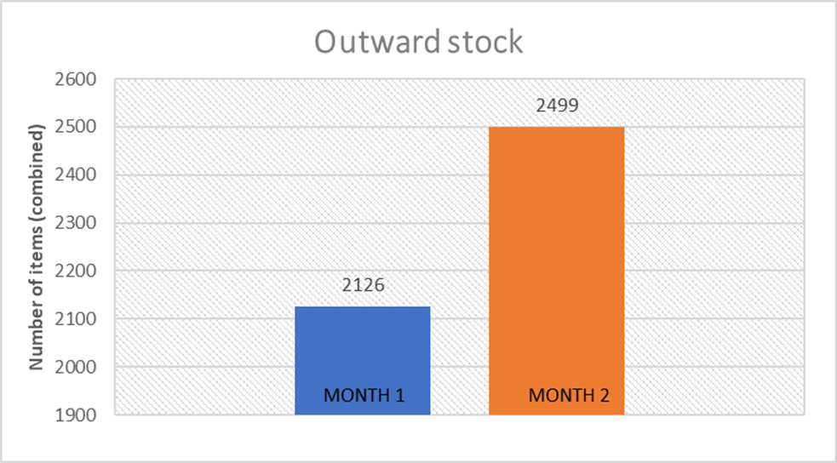
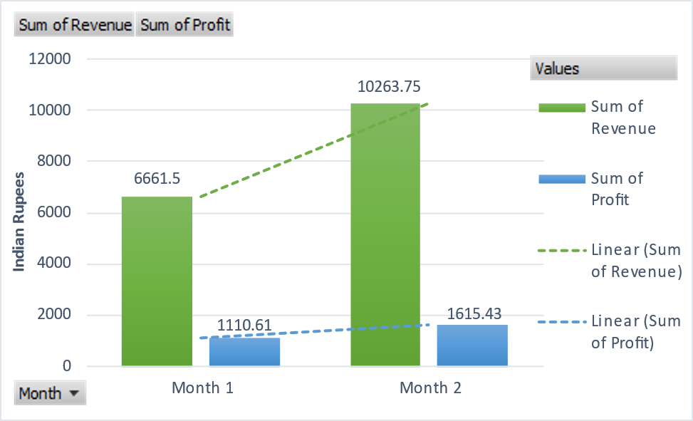
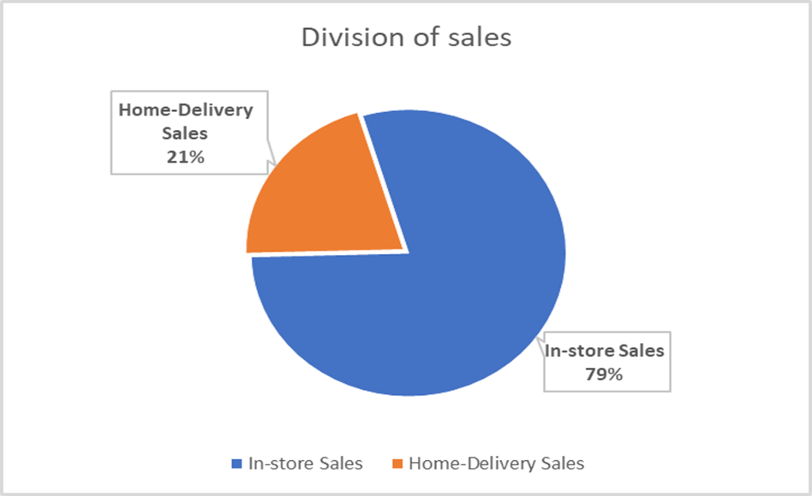
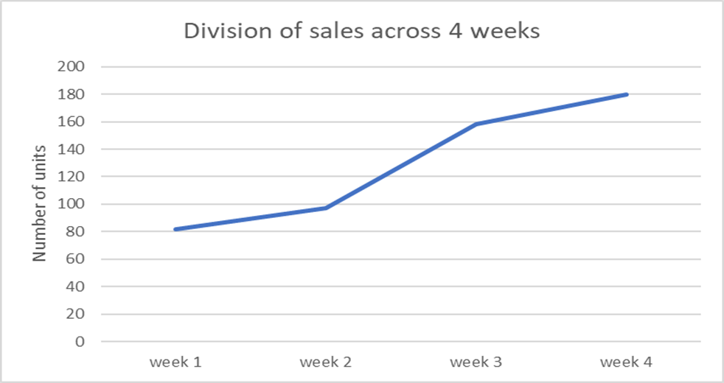
RESULTS
(Here, ‘Month 1’ represents data from last month before Home-Delivery Services were offered and ‘Month 2’ represents data from the first month, wherein Home-Delivery services were offered.)
Introduction of home-delivery services, has shown a staggering 54.08% increase in total revenue generated through sales
Consequently, we see a 45.5% increase in total profit generated through sales.
And a notable 17.6% increase in total outward stock (combined).
We also see an additional ₹1500 generated through delivery charges alone.
We can see about 21% of the sales being diverted to Home-deliveries.
In week 1, the new service was only advertised by the shop keeper, to in-store customers .Seeing the need for marketing, a poster pasted in different places, through the week 2. We see a spike of 62.9% in delivery orders, following this through week 3 and 4.

Slide 8
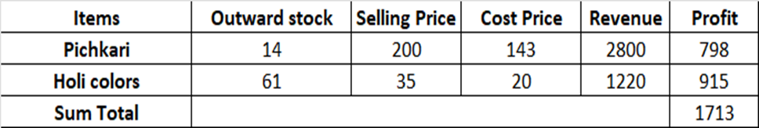
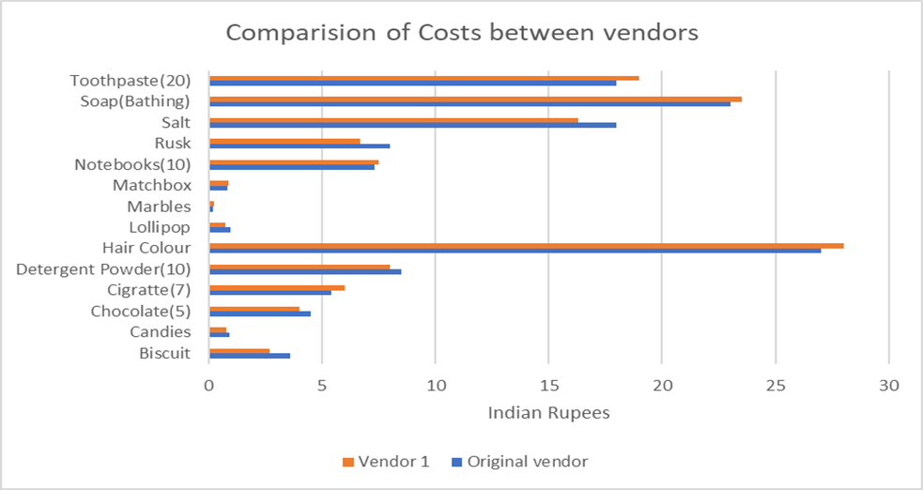
RESULTS
The expansion onto seasonal items led to a significant ₹1713 being generated through Holi merchandise like Holi colors and water guns. It was also noted that the demand surpassed anticipated sales, and should be increased in both quantity, and variety, for the following festivals.
2 offers were put out temporarily, only on in-store purchases, on pens and lollipops due to overstocking and nearing of expiry date respectively. As expected, the inventory of both, the pens and lollipops were lessened to manageable quantities.
Vendor 1 specialized in wholesale of edible items, and sold them at 13.22% less than the original vendor, however charges 5.52% more for non-food items. The most optimal method was to obtain biscuits, candies, chocolates, lollipops, rusk and salt from vendor 1 bimonthly while purchasing the rest, from the original vendor monthly. This gave a noteworthy 17% decrease in overall cost price, and mitigates the problem of overstocking, and spoilage.
The report concludes with a total projected increase in revenue of ₹6815.25 and an anticipated cost reduction of 17%.

Slide 9
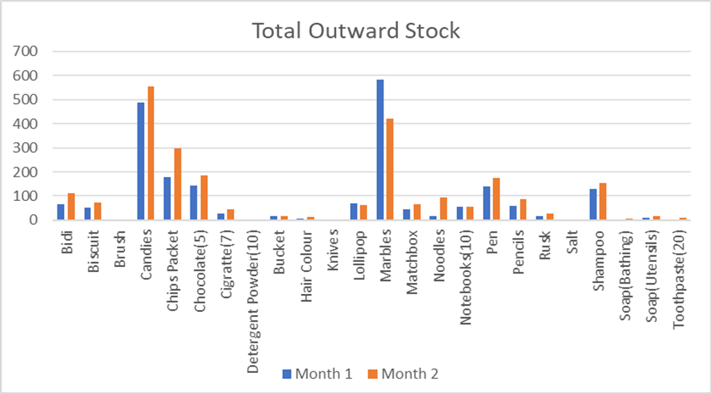
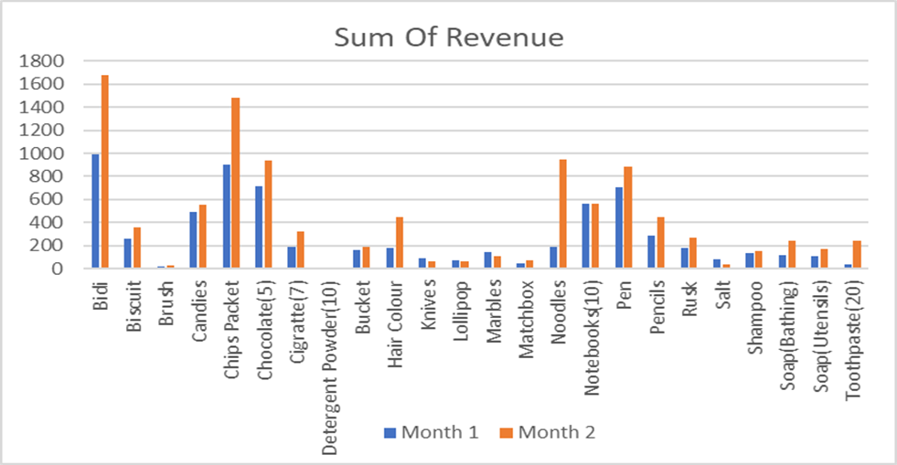
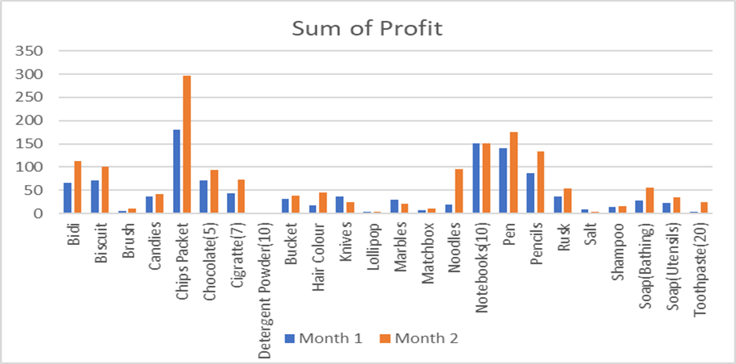
RESULTS
The report concludes with a total projected increase in revenue of ₹6815.25 and an anticipated cost reduction of 17%.

Slide 10
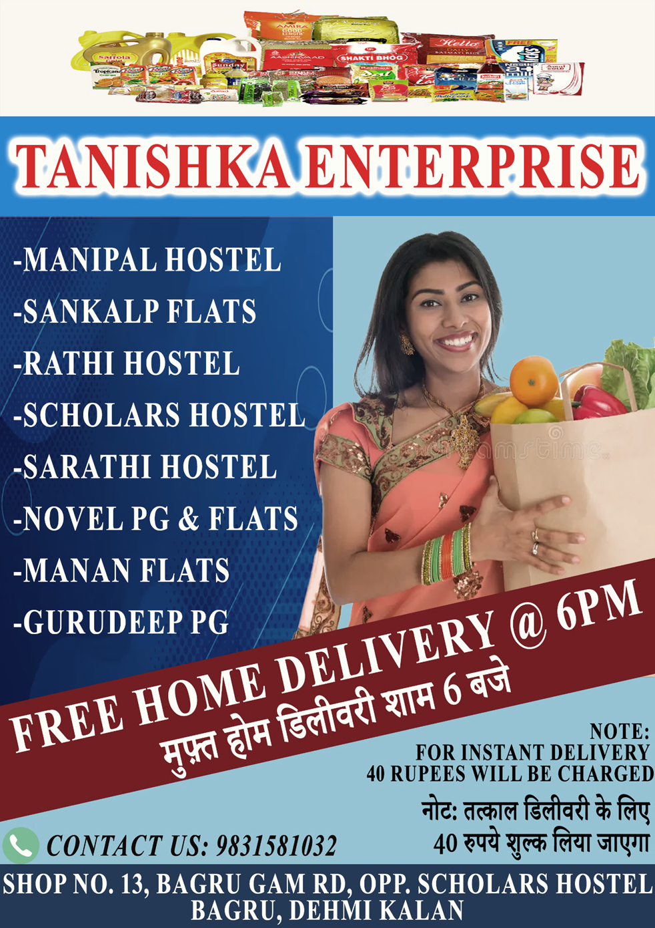

Slide 11
Other Recommendations
Online Presence:
Digitalize transactions:
Supplier Relationships:
Capitalize further on the home-delivery service by establishing an online presence by exploring other delivery platforms in addition to like BlinkIt, Zepto and InstaMart
Keeping track of incoming and outgoing stock, profit margin and inventory management will be significantly fast, easier and error-free by using tools like Excel to manage a database.
Maintain a balance between multiple suppliers for critical inputs like price fluctuations and avoid signing long-term binding contracts.
Seasonal Products:
Offering profitable combos:
Customer base identification
Keep up to date with current trends, festivals and occasions to sufficiently stock up on seasonal items, well in advance, to maintain constant surges of revenue, as well as expand customer base.
Conducting customer surveys or analyzing sales data to identify potential additions to the product range. This will help tap into consumer preferences and provided additional revenue streams.
Versatile and unique combos, based on current movement of items in inventory, not only impact sales, but also help maintain the inventory. This reduces overstocking, expiry, spoilage and wastage.

Slide 12
THANK YOU
First-year revenue of the project
https://docs.google.com/spreadsheets/d/1mGPXVcIT7UWh_0GwHO1rnaSaZHE5VLO25PDcsVCDqhk/edit?gid=350257048#gid=350257048

